Slide 1
Quantitative Research in Political Science How to Analyse Digital Content for Political Science Research
Alex Hartland
Postdoctoral Researcher
Department of European Social Research
University of Saarland

Slide 2
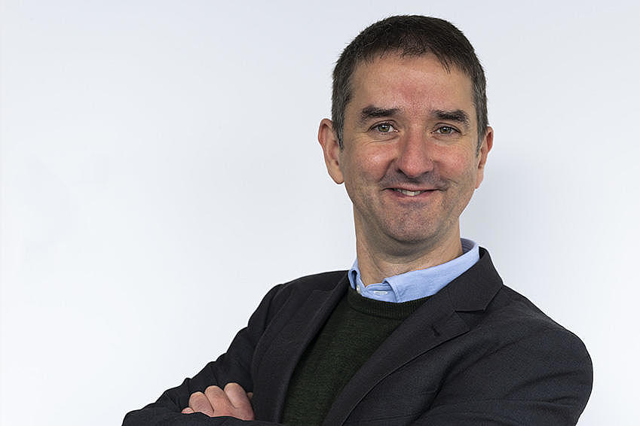
Who am I?
Dr. Alex Hartland
I have been a postdoctoral researcher (Wissenschaftlicher Mitarbeiter) at the chair of Prof. Dr. Daniela Braun since 2023
I studied psychology at the University of Warwick and politics at the University of Manchester, UK
I research political trust and polarisation in European politics as part of the ActEU project
I use surveys and online content to answer questions about current political developments
For our project, we collected content from Twitter/ X, Telegram, and news sites in 10 countries
How can we analyse this and similar content to better understand what is happening online?

Slide 3
...study
How to Analyse Digital Content for Political Science Research!

Slide 4
How to Analyse Digital Content for Political Science Research
Learning Aims
How to collect text, images, and related information online
How to use this information to measure:
- salience - which topics are getting the most attention?
- political attitudes - positive or negative expressions, support or opposition, polarisation, trust, democratic values
- political behaviour - likes, reposts, follows, participation, protest, radicalisation
How to compare results across political actors, parties, platforms, and countries to address research questions
For example:
Which parties focus on which topics?
Are parties becoming more polarised over time?
How do we know our results are accurate?
Can we use this information to predict future events? (spoiler: yes, but not reliably!)

Slide 5
Structure of the course
Class 7 – Introduction: course overview, technical set up, where to find content
Class 8 – Getting an Overview: import, clean, and measure quantities at scale
Class 9 – Going Deeper: using word embeddings to measure attitudes
Class 10 – New Developments: analysing text with Large Language Models
Class 11 – Other content: images, video, and the future of online content analysis
Class 12 – Review/ Applying Text Analysis to your own research question

Slide 6
Is this useful?
Do you want to become a political scientist?

Slide 7
Is this useful?
Do you want to become a political scientist?

Slide 8
Is this useful?
Do you want to become a political scientist?

Slide 9
Is this useful?
Do you want to become a political scientist?
No problem!

Slide 10
Is this useful?
Do you want to become a political scientist?
No problem!
The course teaches you foundational skills for:
Data science
Machine learning
Market research
Brand management
Digital journalism
Cyber security
Legal analysis
Financial planning and more...

Slide 11
Thank you for your attention!

